Slide 1
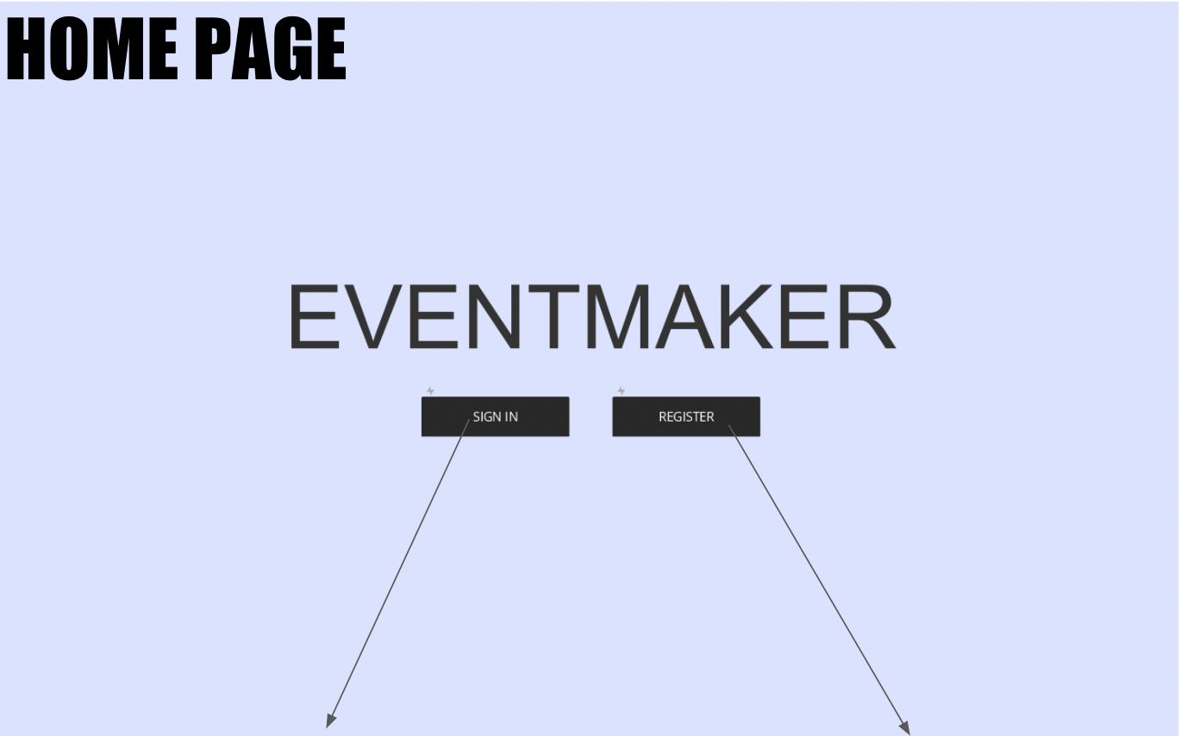
View name: homepage.html
UIs that correspond to this route: icon_button for the two clickable buttons
Sign-In Button will correspond with showing the login page
Register button will correspond with showing the registration page
Database field names for Sign In:
username
password
Database field names for all input fields for Registering:
username
password

Slide 2
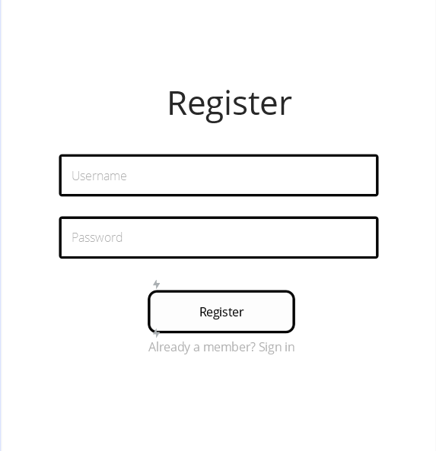
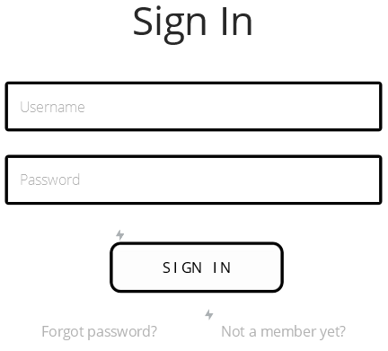
REGISTER & SIGN IN PAGES
UIs that correspond to both of these routes: icon_button : for the two clickable buttons, text_input: for the password and username fields, external_link for the links in grey: “Already a member”, “Forgot Password”, “Not a member yet.”
View name: register.html
View name: login.html
Sign In Link will correspond with account page
Forgot Password? Link will correspond with showing the forgot password page
Not a member yet ? Link will correspond with the register page
Register Link will correspond with showing the new user page
Already a member? Link will correspond with the sign in page
Database field names for all input fields for Registering:
username
password
Database field names for all input fields to Sign in:
username
password

Slide 3
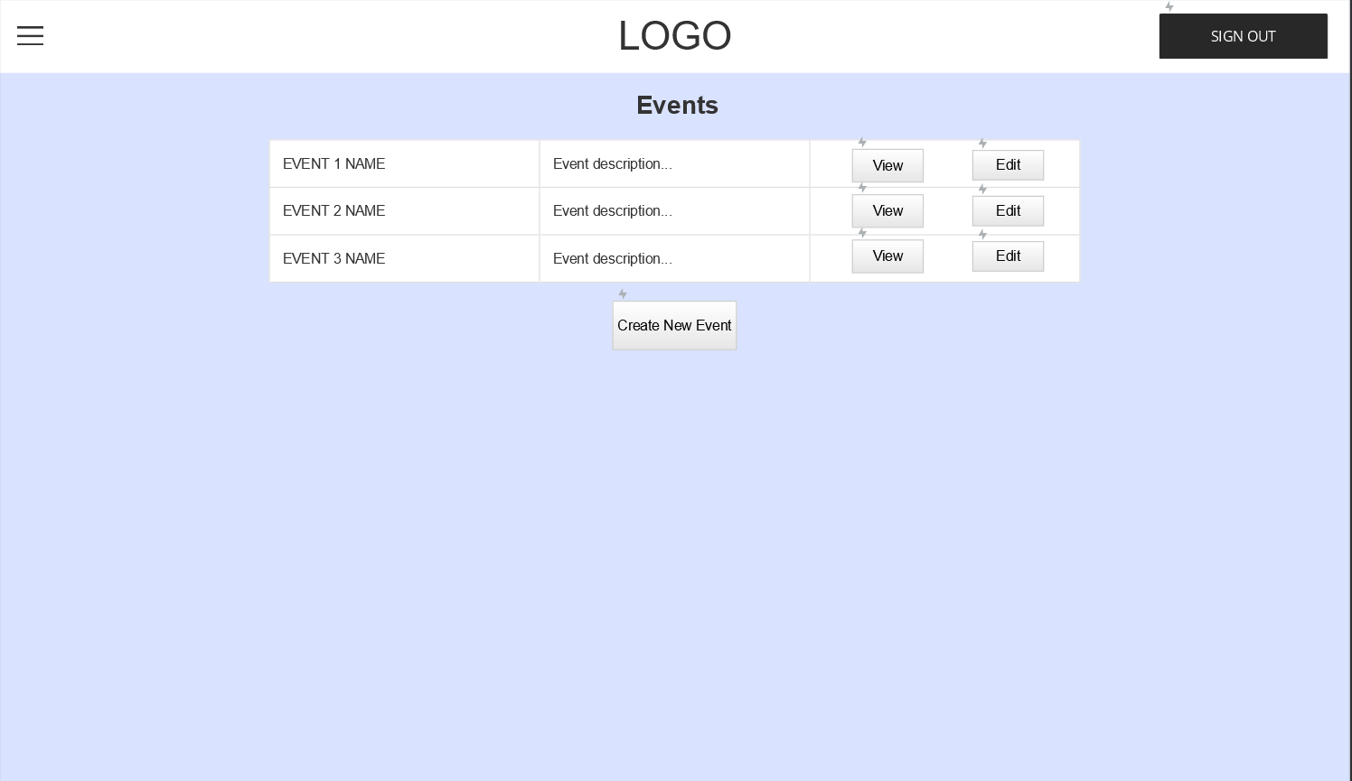
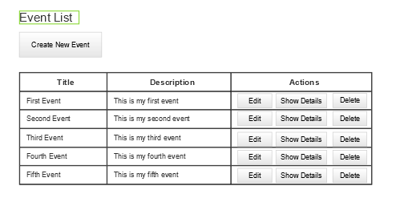
Edit Button will correspond with showing the edit event page
Sign Out Button will correspond with logout page
Show Details Button corresponds with showing the event details page for the selected event
Delete Button will correspond with an updated version of the event list page in which the deleted event will no longer appear
Create New Event Button will correspond with showing the new event page
UIs that correspond to this route: icon_button for all the buttons: edit, show details, delete, create new event, sign out and dropdown_menu for the navigation menu
EVENT PAGE
View name: events.html
Database field names:
action_chosen (based on which action user selects from edit, show details, or delete)

Slide 4
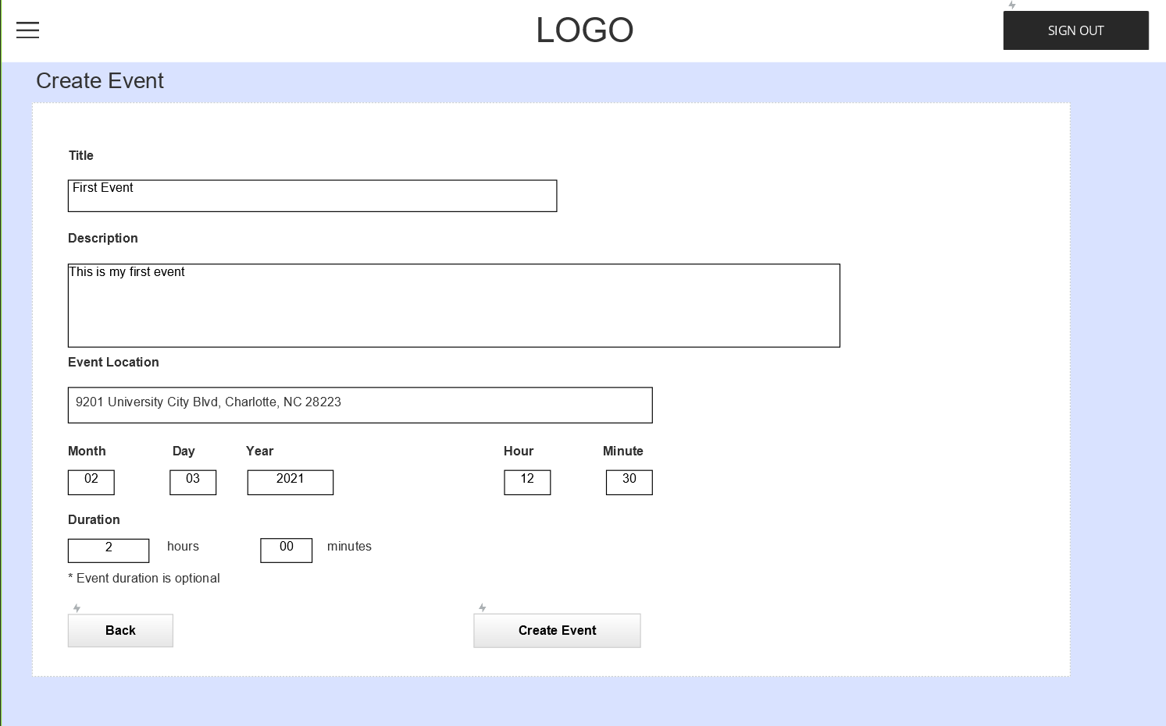
NEW EVENT PAGE
UIs that correspond to this route: icon_button for all the buttons: back, create event. text_input for all the text fields: title, description, location, month, day, year, hour, minute, hours, minutes and dropdown_menu for the navigation menu
View name: newevent.html
Database field names:
event_title: the title of the event
event_description: details about event
event_location: location of the event
date_month: month event will occur
date_day: day event will occur
date_year: year event will occur
time_hour: hour event will start
time_minutes: time event will start (minutes)
duration_hours: hours event will take
duration_minutes: minutes event will take
menu_selection: based on what the user selects from the drop down navigation menu
Sign Out Button will correspond with logout page
Sign Out Button will correspond with logout page
Drop Down Menu will correspond with the page the user selects
Back Button will correspond with previous page
Create New Event Button will correspond with showing the new event page

Slide 5
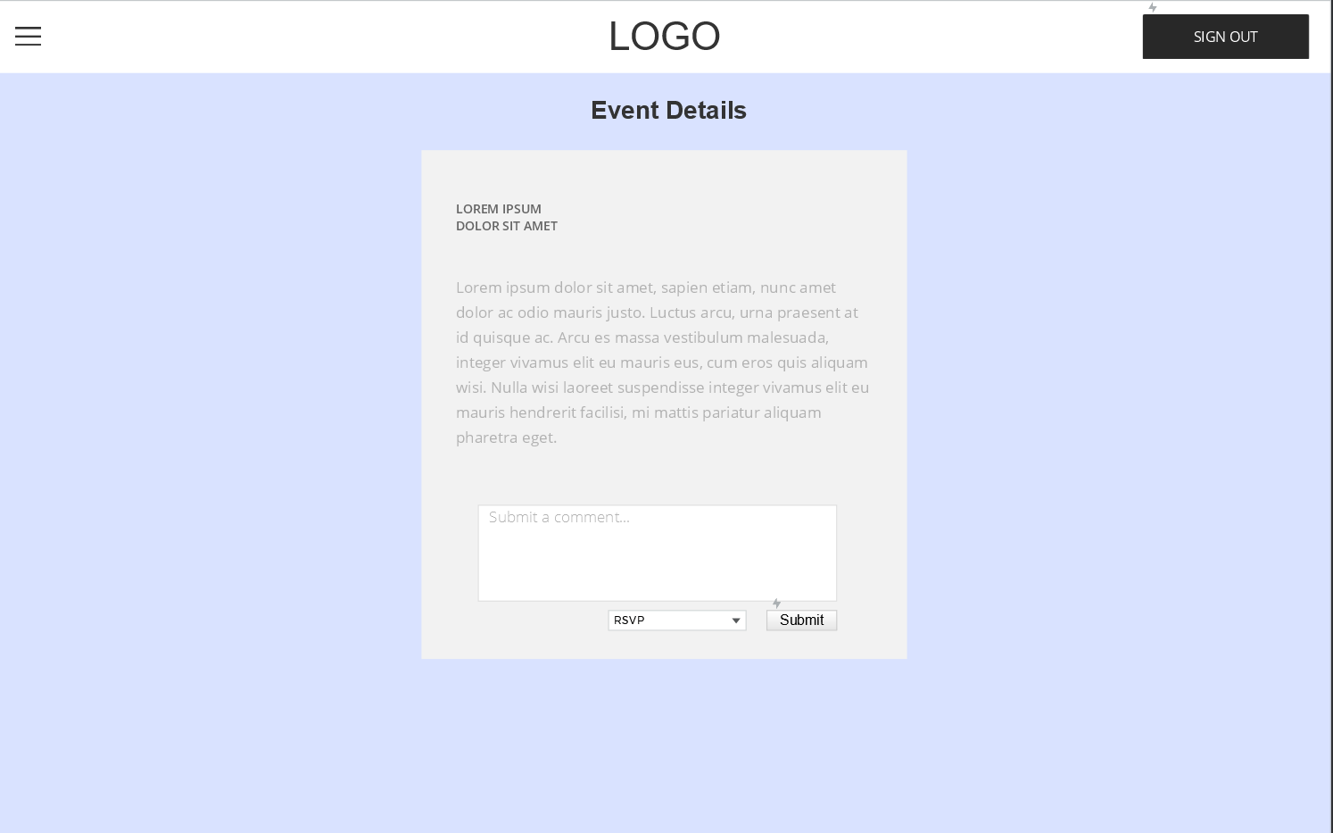
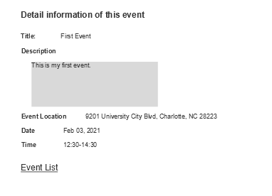
Sign Out Button will correspond with logout page
Drop Down Menu will correspond with the page the user selects
Database field names:
menu_selection: based on what the user selects from the drop down navigation menu
Event List Link will correspond with the event list page
UIs that correspond to this route: icon_button for the sign out button, external_link for the Event List link and dropdown_menu for the navigation menu
EVENT DETAILS PAGE
View name: eventdetails.html

Slide 6

Database field names:
updated_event_title: the updated title of the event
updated_event_description: the updated details about event
updated_event_location: the updated location of the event
updated_date_month: the updated month the event will occur
updated_date_day: the updated day the event will occur
updated_date_year: the updated year the event will occur
updated_time_hour: the updated hour event will start
updated_time_minutes: the updated time event will start (minutes)
updated_duration_hours: the updated hours event will take
updated_duration_minutes: the updated minutes event will take
menu_selection: based on what the user selects from the drop down navigation menu
Drop Down Menu will correspond with the page the user selects
Sign Out Button will correspond with logout page
Back Button will correspond with previous page
Update Event Button will correspond with updating the event and redirecting the user back to the event list page
EDIT EVENT PAGE
View name: updateevent.html
UIs that correspond to this route: icon_button for the back and update event buttons, and dropdown_menu for the navigation menu

